Slide 1
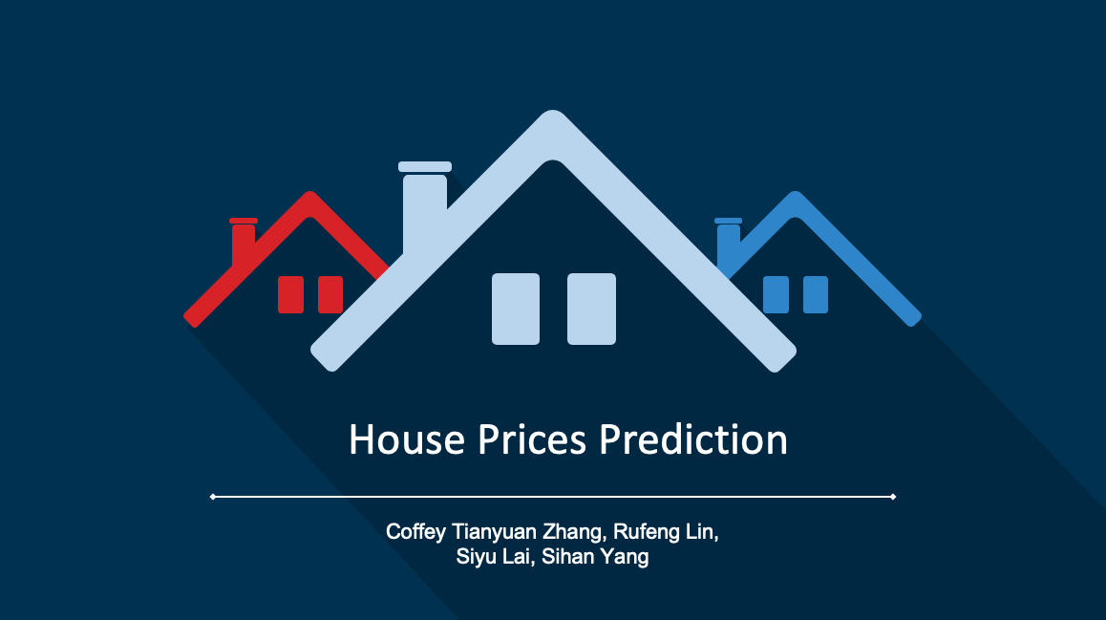

Slide 2


Objectives
The purpose of this project is to use necessary tools and course frameworks to analyze dataset of real estate in Ames, Iowa, predict the final price for each house and make different types of market reports for various demands

Slide 3

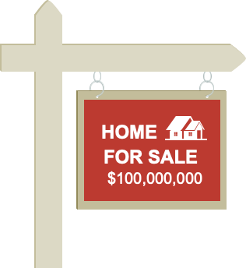
Dataset & Analytics Approach

